Slide 1
Introduction to Objects in Python
By: Iman Khani Jazani
Senior Data Scientist, Adin
Technical AI Product Manager and Advisor, Mehra
AI and Data Specialist, AiHum
Adjunct Professor, Sharif University of Technology

Slide 2
Last Lecture
Short Presentation
Review the Last Lecture
Problem Modeling
Data types in Python
Interpret your commands with Python
Programming with Python
Application of Programming in the Digital Age!

Slide 3
Today
Short Presentation
Review the Last Lecture
What are objects in real world and Python?
What are statements from flowchart view?
Programming with Python
Application of Programming in the Digital Age!

Slide 4
Together
Send your feedback about the class whenever you want!

Slide 5

Contact me
Gmail: ImanKhaniJazani@gmail.com
LinkedIn: https://www.linkedin.com/in/ImanKhaniJazani/
Telegram: @IKJ1992

Slide 6

Main links for our class
گروه خصوصی شد!
Telegram group: *
GitHub organization: github.com/SharifPythonSpace

Slide 7
Grading
راه جبران هم تحت شرایطی وجود داره!
Approx. 25% Programming Assignments (judgment with Quera)
Approx. 14% Mid-term Project (alone, judgment with TAs and Quera)
Approx. 37% Final Project (team work~5 member, judgment with TAs and Quera)
Proposal (about real needs)
Coding
Release
Approx. 30% Final Exam (algorithm-based paper exam)
Approx. 5% Short Presentation(extra score , for the next week lecture, only for the first two person)
Approx. 2% Challenging Questions and Contributions in Class (extra score)
Approx. 7% long presentation (extra score)
Notes:
120 score

Slide 8
Short Presentations

Slide 9
Design and explain a flowchart for a simple Homsa! You can propose new features!
Who is volunteer for the short presentation?
Short Presenration

Slide 10
Review the Last Lecture

Slide 11
From question to algorithm!
Understand your needs or questions!
explain easily for someone else
Decompose your problem (make some steps)!
Make a flowchart for the decomposed version of your problem
Explain each steps in one or two sentences (paper-based or paperless)
input, output, process
Explain each steps mathematically…
Develop your algorithms for each steps
Check your process flow from the first step to the last one!

Slide 12
Different problem, different data!
You can encounter with different types of data in input, output, or even in process (auxiliary)
Tabular
Numerical
Audio
Text
Image
Video
List of items
…

Slide 13
Data in Python
Primitive data
Numbers
Int, float, complex
String
List
Tuple
Set
dictionary
User-defined data
Class
single
sequence

Slide 14
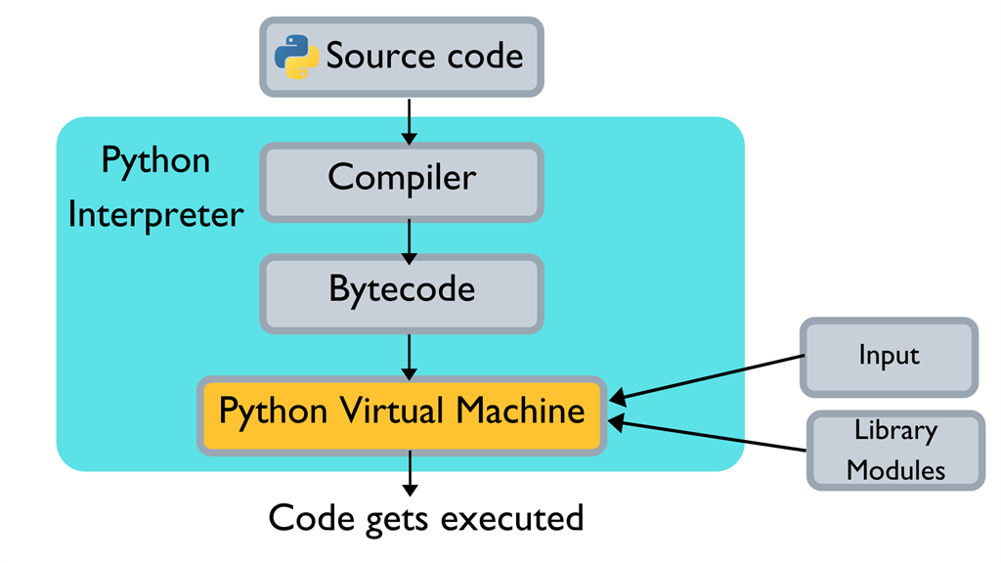
How Python Works

Slide 15
What are objects in real world and Python?

Slide 16
Everything in Python is an OBJECT!🙄 OOP!?🤯

Slide 17
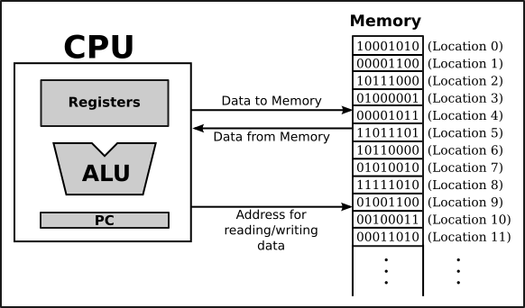
Memory stores information in what way?
Program
Data

Slide 18
How can computer detect which locations in memory are instruction or value or …?
Who is volunteer for the short presentation?
Short Presenration

Slide 19
What is garbage collector? How can do this job?
Who is volunteer for the short presentation?
Short Presenration

Slide 20
So, where is our data???
id(.)

Slide 21
How can CPU process our code?
On the level of machine language, the operation of the CPU is fairly straightforward (although it is very complicated in detail). The CPU executes a program that is stored as a sequence of machine language instructions in main memory. It does this by repeatedly reading, or fetching, an instruction from memory and then carrying out, or executing, that instruction. This process:
fetch an instruction, execute it, fetch another instruction, execute it, and so on forever…
is called the fetch-and-execute cycle.

Slide 22

Object-oriented Thinking

Slide 23
اجاره گیرنده
اجاره دهنده
راننده ماشین
بیمه
گردش مالی
سه تا ضامن
محدوده
گواهینامه
کارت ملی و مشخصات
دسته چک
بررسی سوسابقه
سوسابقه رانندگی
فروشگاه دار
بنزین
پارکینگ
ماشین

Slide 24
Data and other things in Python are object!
Primitive data
Numbers
Int, float, complex
String
List
Tuple
Set
dictionary
User-defined data
Class
single
sequence

Slide 25
What are statements from flowchart view?

Slide 26
The most simple statement!
Assignment
Variables are created by assignment (=)

Slide 27
What is variable?
One of the most powerful features of a programming language is the ability to manipulate variables. A variable is a name that refers to a value.

Slide 28
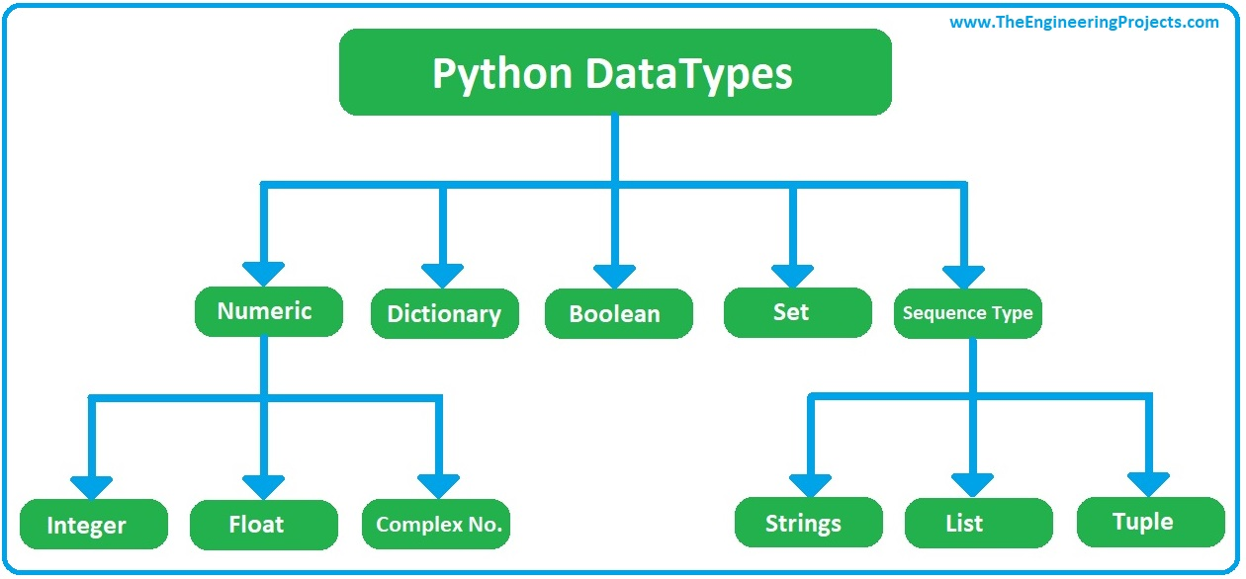
How python can find type of variables?

Slide 29
What is the difference between expression and statement?
😵
www

Slide 30
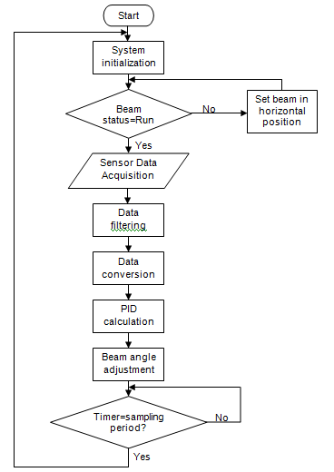
We have different types of statement!
Simple statement (+)
Loop statement (while)
Control statement (if)

Slide 31
Programming with Python

Slide 32
Question
What is the website need?
How can we get more users for our news website?

Slide 33
From question to algorithm!
Understand your needs or questions!
explain easily for someone else
Decompose your problem (make some steps)!
Make a flowchart for the decomposed version of your problem
Explain each steps in one or two sentences (paper-based or paperless)
input, output, process
Explain each steps mathematically…
Develop your algorithms for each steps
Check your process flow from the first step to the last one!

Slide 34

What is your solution?
Input?
Output?
Process?

Slide 35
Application of Programming in the Digital Age!

Slide 36
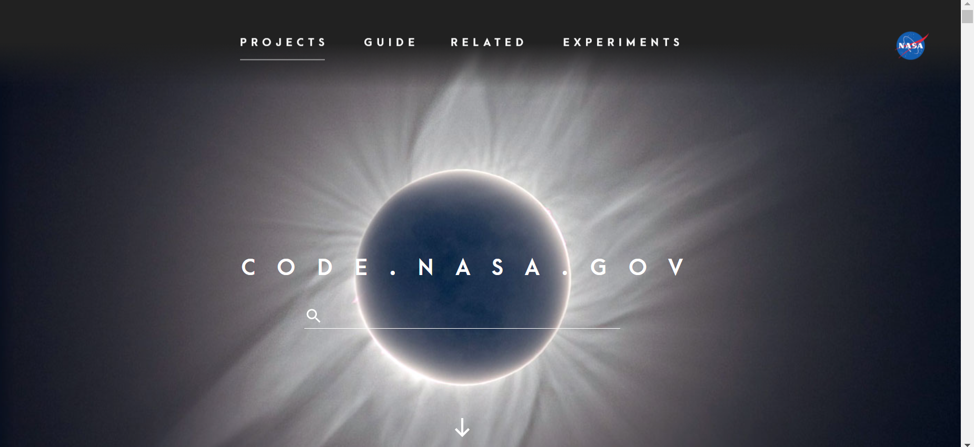
code.NASA.gov

Slide 37
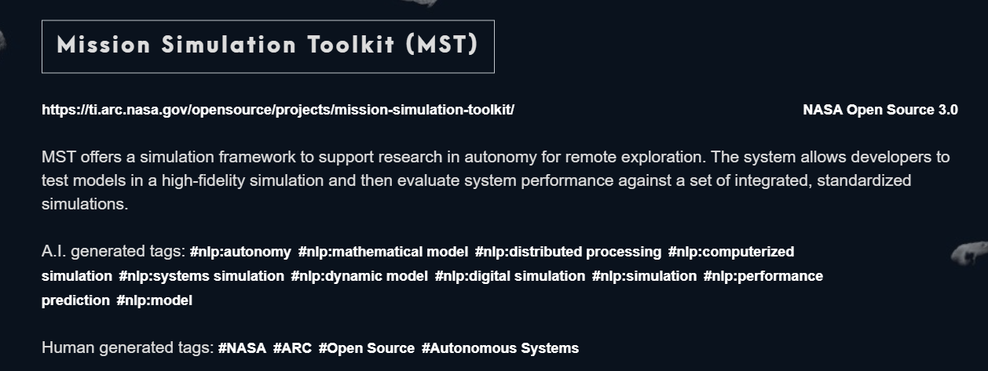
Project 1

Slide 38
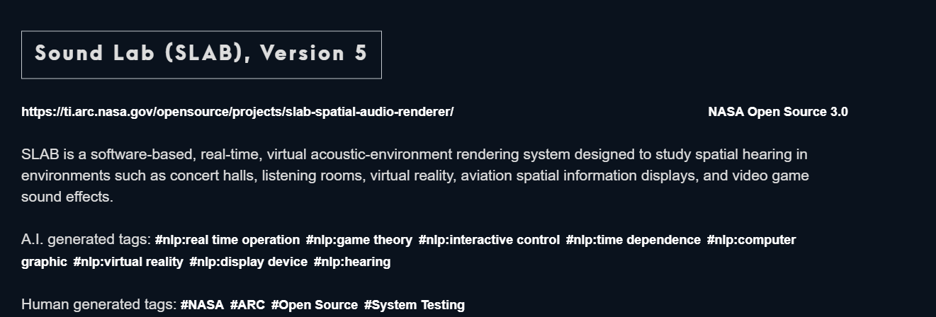
Project 2

Slide 39
Lecture Resources
https://math.hws.edu/eck/cs124/javanotes6/c1/s1.html#:~:text=When%20the%20CPU%20executes%20a,of%20a%20sequence%20of%20locations.
https://towardsdatascience.com/python-memory-and-objects-e7bec4a2845
P. Wentworth, J. Elkner, A. B. Downey, C. Meyers. How to Think Like a Computer Scientist: Learning with Python. 3rd Edition, Open Book Project, 2011.

